Slide 1
TSP- AI ML Fundamentals (Capstone Project)
An End-to-End Data Science Project with ChatGPT
Presented By:
Nithish kumar N - au810021102024
Guided By: Ramar Bose Sr. AI Master Trainer

Slide 2
OUTLINE
Problem Statement
Proposed System/Solution
Algorithm & Deployment
GitHub Link
Project Demo(photos / videos)
Conclusion
Future Scope
References

Slide 3
Problem Statement
This project aims to create a loan approval system using machine learning and ChatGPT's NLP. It will analyze past loan data to predict creditworthiness for new applicants. Integrating ChatGPT automates customer interactions, improving the loan application process. By combining analytics with conversational AI, it aims to boost accuracy and speed of approvals, enhancing the user experience for applicants and loan officers.

Slide 4
Proposed Solution
The proposed end-to-end data science project with ChatGPT and a loan dataset involves data preprocessing, feature engineering, and training a machine learning model for loan approval prediction. Integration of ChatGPT enables a conversational interface for user inquiries and assistance. Thorough testing ensures model accuracy in real-world scenarios.

Slide 5
Algorithm & Deployment
Data preprocessing: Clean and prepare loan dataset, handle missing values and outliers.
Feature engineering: Extract relevant information to enhance model performance.
Machine learning model training: Train model (e.g., logistic regression, random forest) to predict loan approval/rejection based on historical data.
Integration of ChatGPT: Enable conversational interface for user inquiries and assistance.
Testing and evaluation: Ensure model accuracy and effectiveness in real-world scenarios.

Slide 6
GitHub Link
https://github.com/au810021102024nithishkumar/au810021102024- Nithish-kumar-N.git

Slide 7
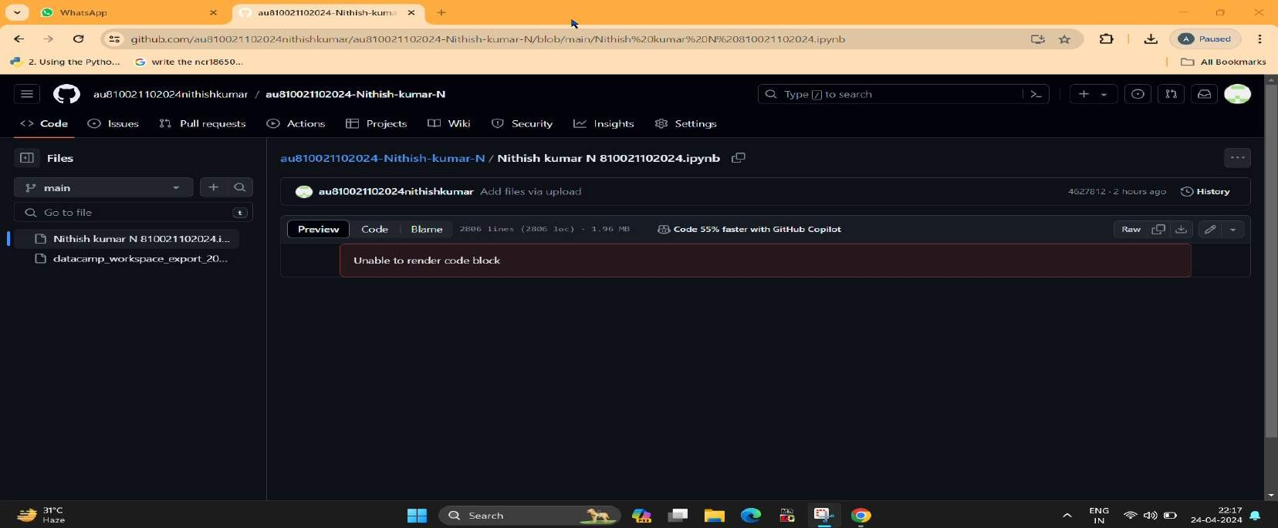
Project Demo ( Recorded Video )

Slide 8
Conclusion
Implementing an end-to-end data project with ChatGPT for a loan dataset enhances customer engagement and service efficiency in lending.
Through NLP, it facilitates seamless communication, providing instant
assistance and guidance. Meticulous data preprocessing, model training, integration, and deployment ensure accurate and relevant responses, streamlining the user experience. Continuous monitoring and updates make the system adaptive and responsive to evolving user needs, optimizing loan management processes.

Slide 9
Future Scope
In the future, leveraging ChatGPT for loan datasets offers exciting prospects. Advancements in NLP and ML will enable sophisticated loan application systems. Integration of diverse data sources like social media or transaction history can enhance risk assessment. Voice recognition can improve accessibility. Collaboration with financial institutions and regulators can ensure trust and compliance. Overall, the future of ChatGPT in loan management holds great promise for innovation and financial inclusion.

Slide 10
References
Project Github link, Ramar Bose , 2024
Project video recorded link (youtube/github), Ramar Bose , 2024
Project PPT & Report github link, Ramar Bose , 2024

Slide 11
THANK YOU

